Slide 1
SAP BW/4HANA

Slide 2
Outline
Data Warehouse
Reference Architectures
In-memory Appliance Development
SAP HANA
SAP BW/4HANA: Architecture
SAP Business Intelligence Platform
SAP BW/4HANA Objects

Slide 3
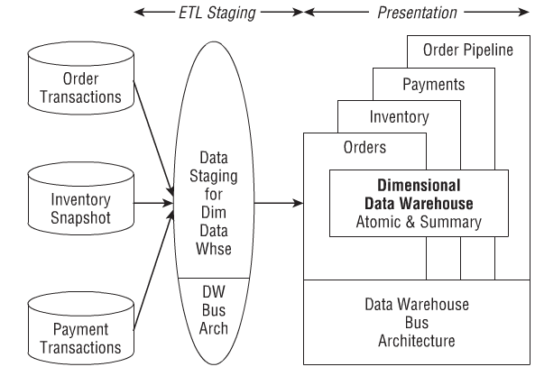
Kimball’s Dimensional Data Warehouse

Slide 4
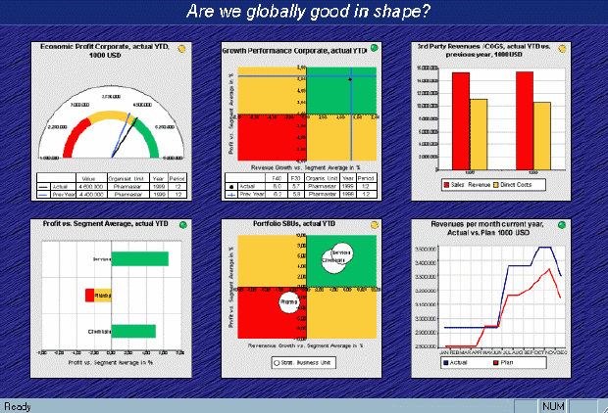
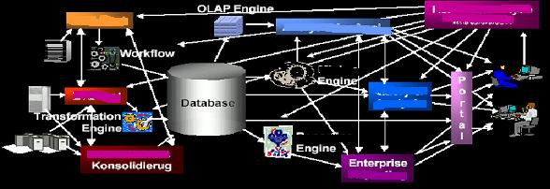
Business Intelligence Reference Architecture
Dashboards, …
Planning, scorecard, …
Data analysis and
analytical applications
Information models
Aggregation
Multi-dimensional data
Data storage
Administration
Data warehouse
Selection, extraction
Modification, loading
Extraction, trans-
formation, loading
Source systems
External data sources
Internal data sources

Slide 5
Data Warehousing Architecture Alternatives
Notes:
Businesses that need aggregated historical data for analytics often set up a complementary data warehouse. Similarly, if a business with a data warehouse needs current, integrated operational data for day-to-day functioning, it can implement an ODS. (stitchdata.com)

Slide 6
SAP HANA Transformation
SAP ERP → SAP S/4 HANA
SAP BW → SAP BW/4HANA
SAP Analytics → SAP Predictive Analytics with HANA
SAP Cloud/4HANA

Slide 7
In-Memory Appliance Development (1)
Large amount of RAM
Persistent Memory (PMEM)
  Data retained when there is power outage
  Cheaper than DRAM (Dynamic Random Access Memory)
  Available in much larger size
HANA (High-Performance Analytic Appliance) natively uses PMEM alongside DRAM
Can have up to 128 TB of memory
  Possible to store entire database in memory

Slide 8
In-Memory Appliance Development (2)
Factors that enable in-memory database in SAP HANA
  Huge amounts of memory
  Automatic data compression
  Data tiering
    Hot data stored in memory
    Warm data stored on disk

Slide 9
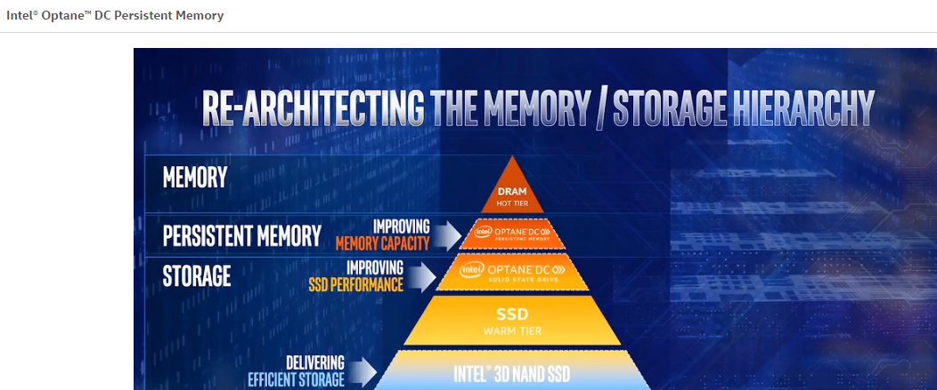
Persistent Memory (PMEM)
Lower latency for data access compared to disk access

Slide 10
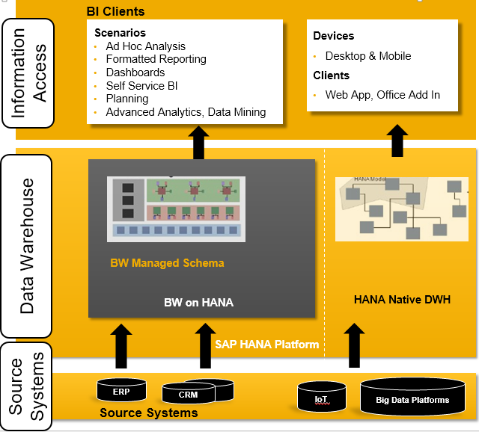
SAP BW HANA: Architecture

Slide 11
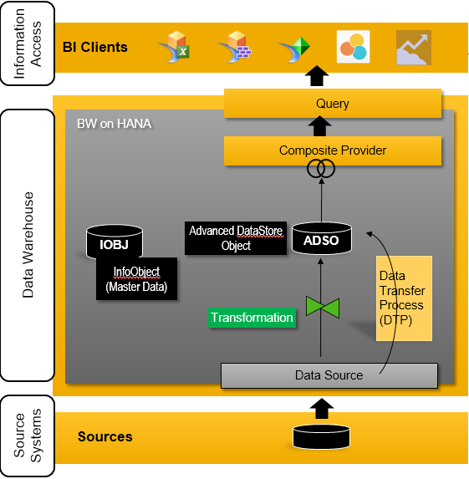
SAP Business Intelligence Platform

Slide 12
Data Source
A data source is the internal representation of an external source of data for a specific source system
  Field list (order of fields, data types, length, ...)
  Adapter specific settings (e.g., type of file)
  Persistency

Slide 13
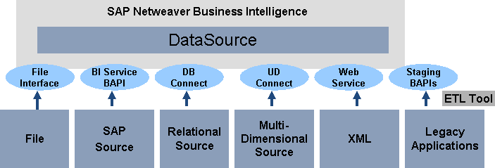
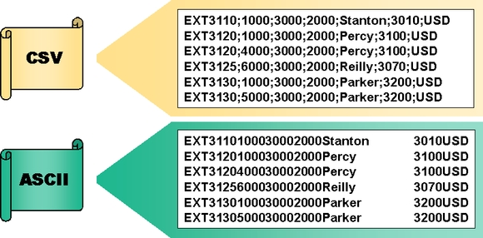
Data Source - File Interface
File name, number of header rows, data format, number format, field list, preview, ….

Slide 14
Modeling Objects in SAP BW/4HANA
SAP BW/4HANA Object | Main Modeling Purpose
InfoObjects | Master data storage
Open ODS Views | Data virtualization
Advanced DSOs | Data persistency
CompositeProviders | Logical layer

Slide 15
What is an InfoObject?
InfoObjects are used to focus on business requirements.
  InfoObjects are the “bricks” to build data structures inside SAP BW
  Technically it can be looked like a database field with properties (e.g., type, length, permitted values)
  InfoObjects represent business objects from an end user’s view
  Main modeling purpose is master data storage
  The most important InfoObject types used for business analysis are Characteristics and Key Figures
    InfoObjects of Characteristic types are contextual elements
    InfoObjects of Key Figure types represent the metrics

Slide 16
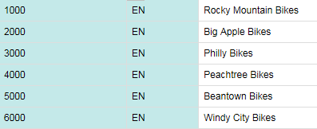
InfoObject: Characteristics (1)
A Characteristics represent a business object (or business entity, business term).
  E.g., Customer, Product, Country, Product Category
  In most cases every item has a key (language independent) and a description (language dependent)
    Example:
Master Data

Slide 17
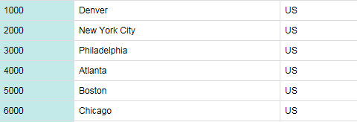
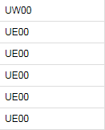
InfoObject: Characteristics (2)
In addition to key and description a characteristic may have attributes which describes the business object in more detail.
  Example: InfoObject “Customer” is a characteristic with attributes such as “Location”, “Sales Organization” and “Country”
Often attributes are used to form hierarchies
  Example: Country → Sales Organization → Customer
Note: What SAP calls a Characteristic is often referred to in the data warehouse community as a Dimension.

Slide 18
InfoObject: Key Figures
A Key Figure (or measure) is often used to document the performance of a business process over time.
  It can be found in document records such as invoice, delivery note, purchase order, goods receipt, etc.
  Examples: “Revenue”, “Sales Amount”
Note: InfoObjects are unique inside SAP BW; they are used to build the data structures for analysis requirements.
  The data type, value range or field length is uniquely defined system-wide inside SAP BW.

Slide 19

InfoObjects are “Bricks” for Data Structures
A Business Transaction can be described by a data record which consists of a combination of characteristics and key figures (and ordinary database fields potentially)
When designing the Data Warehouse system, granularity for storing data has to be designed (single business transactions or higher level; e.g., month)
In Global Bike case Order Number and Order Item are database fields; Calendar day, Customer, Material are InfoObjects of type Characteristics; Sales Quantity, Revenue, Discount are InfoObjects of type Key Figure; the Units are Characteristics
Transaction Data
Notes:
In Global Bike case Order Number and Order Item are database fields;
Calendar day, Customer, Material are InfoObjects of type Characteristics;
Sales Quantity, Revenue, Discount are Infoobjects of type Key Figure;
the Units are Characteristics

Slide 20
Open ODS Views
Open ODS Views enable direct data access without the need to create InfoObjects. (ODS – Operational Data Store)
An Open ODS View is a view on the source object, it does not contain any data persistence. (Purpose – Virtualization)
It is generally used to pull in data from external systems.

Slide 21
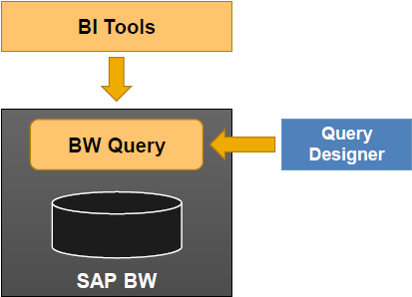
InfoProviders “Provide” Access to Data Records
InfoProviders:
  Are the data containers inside SAP BW providing specific view of data
  May store data records physically (persistent)
  May be accessed with front end tools such as SAP Business Objects Advanced Analysis for Office using a query

Slide 22
InfoProviders
InfoProviders in BW/4HANA:
  Physical data: Advanced Data Store Objects (aDSO)
    Provides data persistency
    Can optimize data for fast multi-dimensional analysis or fast update (different settings)
  Virtual data: Composite Providers
    Can combine data from several other InfoProviders (by Join or Union) and make this data available for reporting/analysis

Slide 23

Advanced Data Store Object (aDSO)
Can consist of InfoObjects and / or ordinary database fields
Main modeling purpose is to provide data persistency

Slide 24
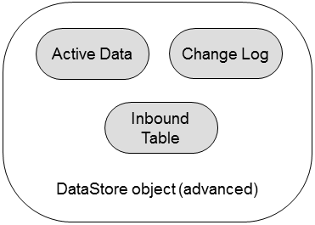
aDSO Structure and Modeling Properties
Consists of a maximum three tables: the Inbound Table, the Change Log and the table of Active Data.
In general, the data is always written to the inbound table.
All reporting done on Union of Inbound and Active Tables.

Slide 25
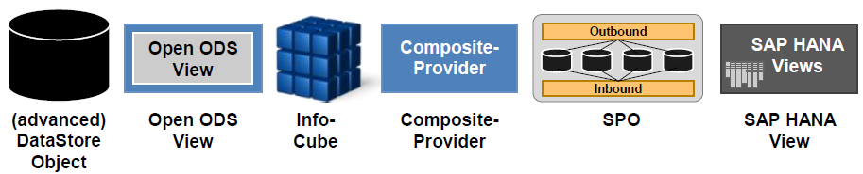
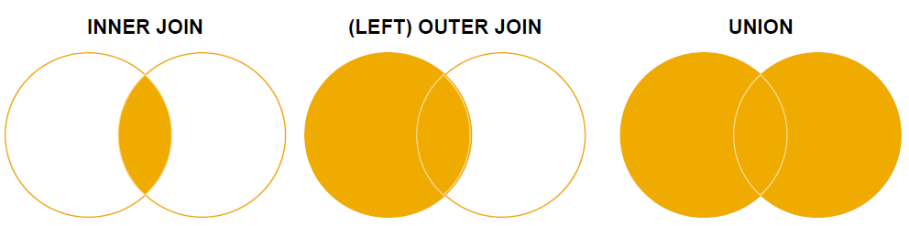
Composite Provider
Does not persist data
Can merge data from different BW InfoProviders and / or HANA views
Can use union and join; supported join types:
Composite Provider provides an additional layer to decouple reporting from data storage
Notes:
More flexibility, Navigation attributes

Slide 26
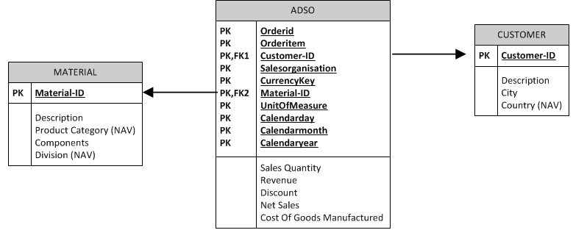
SAP BW/4HANA: Beyond Star Schema
Attributes of InfoObjetcs are added
Characteristic as navigation attribute in Composite Provider
Characteristic as part of a Advanced Data Store Object “All Characteristics are Key”

Slide 27
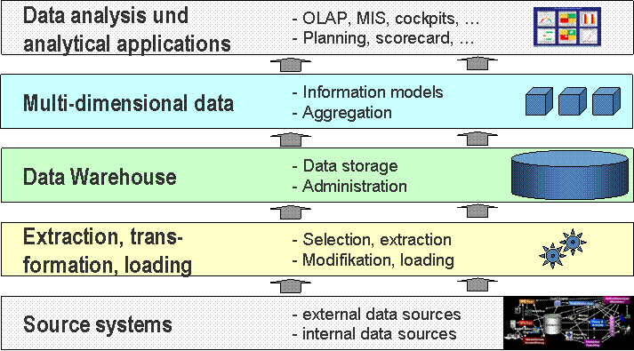
SAP Business Intelligence Platform

Slide 28
Overview – ETL Process
Data Acquisition – Extraction
“Raw data” has to be extracted from the source system (transferred to target by using an InfoPackage)
Different kind of data (master data, transaction data, metadata) can be retrieved via various interfaces from several source systems (e.g., SAP Source, Flat files,..)
Persistent Staging Area (PSA):
Inbound storage area for data from the source systems

Slide 29
Overview – ETL Process
Transformation
During the transformation process data can be consolidated, cleansed, and integrated. It is also possible to combine data from heterogenous sources.
Data Flow Control – Loading
Design and use InfoPackages for loading data

Slide 30
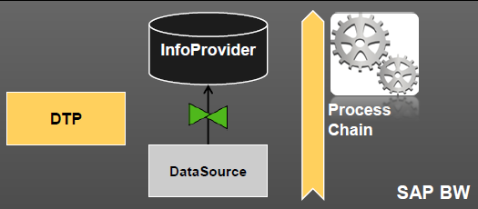
Data Flows in SAP BW
DataSource – interface object to source system representing the source data structure
Transformation – transforms the data according to defined rules
Data Transfer Process (DTP) – triggers the data transfer between a source and target
Process Chain – a sequence of processes that get triggered in a specified order

Slide 31


Example: Transaction Data
DataSource – interface object to source system representing the source data structure; can have persistency (Persistent Staging Area - PSA)
Data is transferred to PSA by an InfoPackage
aDSO
Data
Transfer
Process (DTP)
Transformation
Data Source (PSA)
Info Package

Slide 32
SAP BW Exercises
Building the data warehouse
  BW modeling tools
  Data Acquisition
  Modeling Basics
  Master Data
  Data warehouse
  Hierarchies

Slide 33
Software
SAP GUI
SAP BW/4HANA
Eclipse/BW Modeling Tools in Eclipse

Slide 34
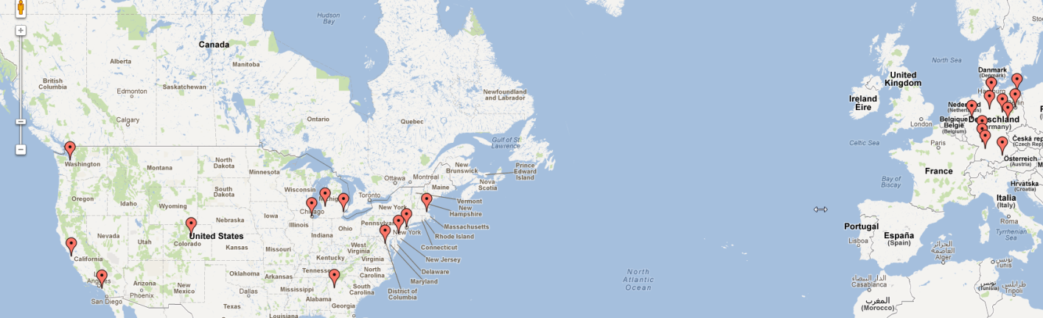

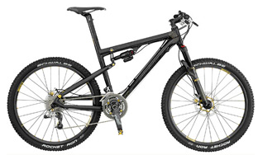


Global Bike Incorporated
Customers in Germany and United States
Bicycles and Accessories
Product Categories:

Slide 35
Global Bike Incorporated
Company in the bicycle business
Manufactures and distributes different product lines of high-quality bicycles
Re-sells accessories for bicycles
Sells to wholesalers

Slide 36
Source
SAP University Alliances
The Kimball Group Reader by Ralph Kimball and Margy Ross
Intel

